Slide 1
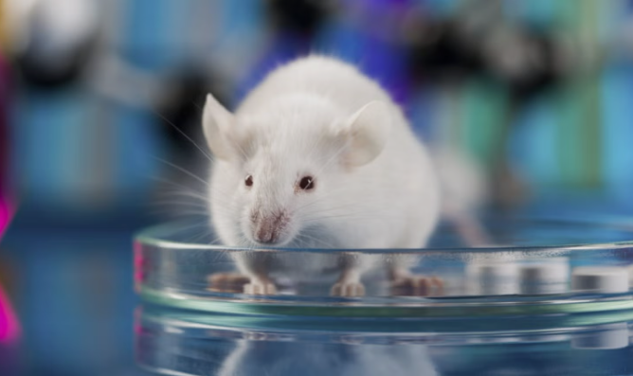



CPCSEA GUIDELINES
PRESENTED BY – JADHAV MRUNALI MILIND
ROLL NO – 523
MPHARM (1st SEM )-QUALITY ASSURANCE TECHNIQUES
GUIDE – MR.SANDEEP GADHWE
CO-GUIDE – MRS.SUVARNA VAKARE

Slide 2
Content
Introduction
Objectives
Some changes in CPCSEA guidelines
CPCSEA guidelines
IAEC
Case study

Slide 3
CPCSEA INTRODUCTION
Committee for the purpose of Control and supervision of Experiments on Animals(CPCSEA)
Statutory body formed by the Act of the Indian Parliament under the Prevention of Cruelty to Animals Act, 1960
Formed in 1964
Revived in 1998
Head quarters at chennai
Includes various guidelines and sub committees
Animal experimentation and ethics in India:the CPCSEA makes a difference Shiranee pereira et.al. Altern Lab Anim 2004 June

Slide 4
CPCSEA INTRODUCTION
It ensures that animal experimentation is carried out humane , ethical, scientifically valid , and legally compliant.
Introduce the credo of 3R Principles
Introduction a national ‘Good Laboratory Practice’
Animal experimentation and ethics in India:the CPCSEA makes a difference Shiranee pereira et.al. Altern Lab Anim 2004 June

Slide 5
OBJECTIVES
Promote human care and welfare of animals.
Implement the principle of the 3Rs/4Rs
To monitor and inspect animal facilities
To minimize pain,suffering and distress during animal experimentation
Promote ethical awareness and training.
Ahimsa and alternative-the concept of the 4th R. The CPCSEA in India Shiranee pereira et.al. ALTEX.2005
Ministry of fisheries, Animal Husbandary and Dairying,Department Of Animal
Husbandry and Dairying Government of india

Slide 6
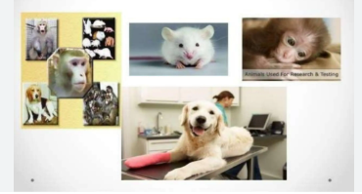
TYPES OF ANIMAL COVERED
Small laboratory animals(rats, mice, guinea, pigs)
Large animals(rabbits, dogs , pigs)
Farm Animals(cattle, Buffalo, sheep , goats , poultry)
Aquatic animals(fish, frog)
Birds(chickens, pigeons)
Ramachandra R. et al., Journal of Laboratory Animal science –Alternative models under CPCSEA regulation.
Yadav A.R., Pharmacology Journal(2020) CPCSEA guidelines for laboratory animal facilities.
Shiranee pereira et al.IJP/IJMR- CPCSEA role in relating large-animal experimentation in India.

Slide 7
CHANGES IN CPCSEA GUIDELINES
The ministry of fisheries ,animal husbandry and dairying have changed the name of the committee that controls and monitors the experiments on animals .
CPCSEA changed to “Committee for the control and supervision of experiments on animals(CCSEA)
Through its order dated January 6,2023
V-110119(13/2022-CPCSEA-DADE Government of India Ministry of fisheries, animal husbandry and Dairying (CCSEA)

Slide 8
The CPCSEA in its 101th meeting has recommended that stray dog may be used for new vaccines trials
Updated fee structures and penalties for late renewal
Gazette notifications issued in 2025 for reconstitution and amendments

Slide 9
CPCSEA GUIDELINES FOR LABORATORY FACILITIES
Veterinary care
Personnel and training
Animal procurement
Quarantine, stabilization and separation
Animal care
Personal hygiene
Sanitation and cleanliness
Animal husbandry
Physical facilities
Indian Journal of Pharmacology 2003, 257-274, CPCSEA GUIDELINCES LABORATORY ANIMAL FACILITIES

Slide 10
Ministry of Environment and Forest
(Animal Welfare)
CPCSEA
IIAEC
IBIBSC/IBC

Slide 11
IAEC
The Institutional Animal Ethics Committee(IAEC)
The aim of IAEC is Protecting animal welfare by minimizing pain,distress and unnecessary use of animal.
It is a legally mandated committee under indian law, specifically under the prevention of Cruelty to Animals Act,1960
Role of IAEC in promoting Human and Ethical Research in in India
Akshada Bhoyarekar,Harsh Prassana Pukale, Dr. Neeraj Vyawahar, Dr.smeeta Sadar

Slide 12
Most of the Nominees of CCSEA are attending the meeting through online mode
And Nominees have stopped inspecting the animal house facilities,thereby compromising the animal welfare.
The CCSEA in its 135th meeting held on 23rd July,2025
has decided that all the IAEC meeting should be conducted physically

Slide 13
And an inspection of the animal house facility
New instructions for animal house inspecton and PI project presentation

Slide 14
CASE STUDY
  A phD student at a veterinary university is researching
  The wound-healing properties of a new herbal gel
  Approval from the IAEC
  Test the gel on 12 rats

Slide 15
DEVIATION
  Student notices that the gel work very well
  They decided to see if it works on burn wounds as well
  Without filling a new form B or asking the IAEC
  Student uses a heated metal rod to create small burns injuries on 6 of the existing rats

Slide 16
THE AUDIT DISCOVERY
CCSEA main nominee checks laboratory logs and notices:
The nature of injury not match the approved protocol
The rats showing sings of daistress
Do not show the use of post-operative analgesics for burn trauma

Slide 17
VIOLATION OF CCSEA GUIDELINES
Protocol Deviation
Refinement
IASC Supervision

Slide 18
CONSEQUENCES
Stop-work order
Data Invalidation
Warning/Blocklisting

